Slide 1
Outline
Introduction
Background
Distributed Database Design
Database Integration
Semantic Data Control
Distributed Query Processing
Multimedia Query Processing
Distributed Transaction Management
Data Replication
Parallel Database Systems
Distributed Object DBMS
Object Models
Object Distribution
Peer-to-Peer Data Management
Web Data Management
Current Issues

Slide 2
Why Object DBMS
Some applications require
storage and management of abstract data types (e.g., images, design documents) ➔ rich type system supporting user-defined abstract types;
need to explicitly represent composite and complex objects without mapping to flat relational model;
need more powerful languages without the impedance mismatch.

Slide 3
Fundamental Concepts
Object
An entity in the system that is being modeled.
<OID, state, interface>
OID: object identifier
Immutable
State
Atomic or constructed value
Atomic values are instance variables (or attributes)
Constructed values can be set or tuple
Interface
State and behaviour
Behavior captured by methods
Object states may change, but OID remains identical

Slide 4
Fundamental Concepts (cont’d)
Type
Domain of objects
Class
Template for a group of objects defining a common type that conforms to the template
Example
type Car
attributes
engine: Engine
bumbers: {Bumper}
tires: [lf: Tire, rf: Tire, lr: Tire, rr: Tire]
make: Manufacturer
model: String
year: Date
serial_no: String
capacity: Integer
methods
age: Real
replaceTire(place, tire)

Slide 5
Fundamental Concepts (cont’d)
Composition (aggregation)
Composite type (Car) and composite object
Allows referential sharing – objects refer to each other by their OIDs as values of object-based variables
Composition relationships can be represented by composition (aggregation) graph
Subclassing and inheritance
Subclassing is based on specialization: class A is a specialization of class B if A’s interface is a superset of B’s interface.
Inheritance: result of subclassing – class A’s properties consist of what is defined for it as well as the properties of class B that it inherits

Slide 6
Object Distribution
New problems due to encapsulation of methods together with object state.
Fragmentation can be based on
State
Method definitions
Method implementation
Class extent can be fragmented

Slide 7
Fragmentation Alternatives
Horizontal
Primary
Derived
Associated
Vertical
Hybrid
Path partitioning

Slide 8
Horizontal Fragmentation
Primary
Defined similar to the relational case
Derived
Due to the fragmentation of a subclass
Due to fragmentation of a complex attribute
Due to method invocation

Slide 9
Vertical Fragmentation
For a class C, fragmenting it vertically into C₁, …, C_{m} produces a number of classes, each of which contains some of the attributes and some of the methods.
Each fragment is less defined than the original class
Issues
Subtyping relationship between C’s superclasses and subclasses and the fragment classes
Relationship of the fragment classes among themselves
Location of the methods when they are not simple methods

Slide 10
Path Partitioning
Clustering all of the objects forming a composite object into a partition
Can be represented as a hierarchy of nodes forming a structural index
Each node of the index points to objects of the domain class of the component object

Slide 11
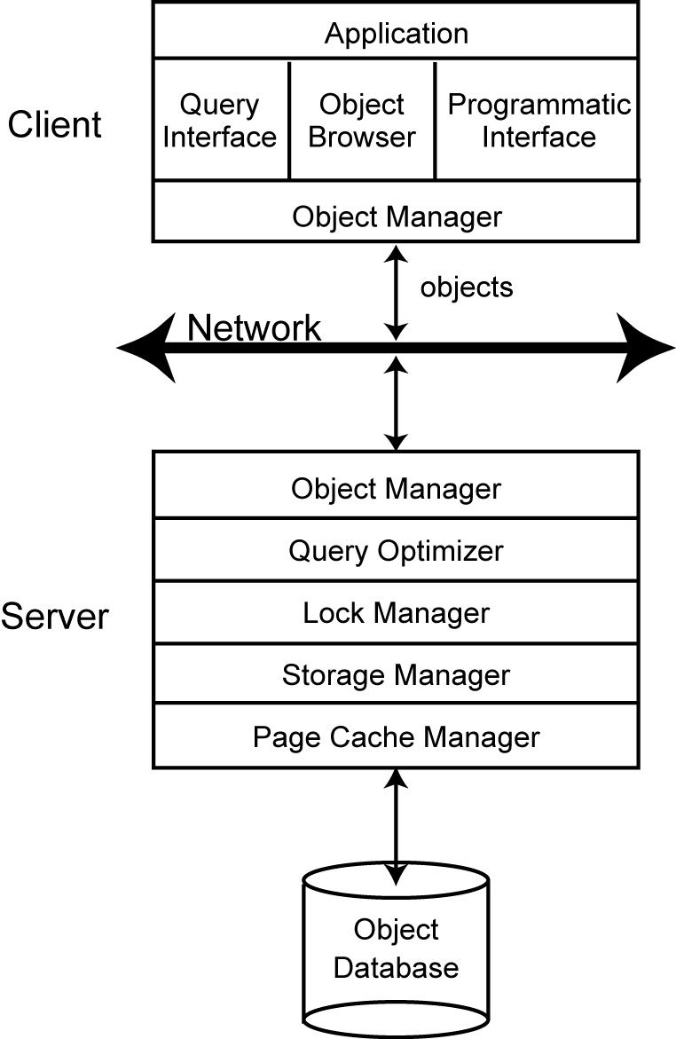
Object Server Architecture
Clients request “objects” from the server
Single object or groups of objects can be returned
Server undertakes most of the DBMS services
Object manager duplicated
Provides a context for method execution
Implementation of object identifier
Object clustering and access methods (at server)
Implement an object cache

Slide 12
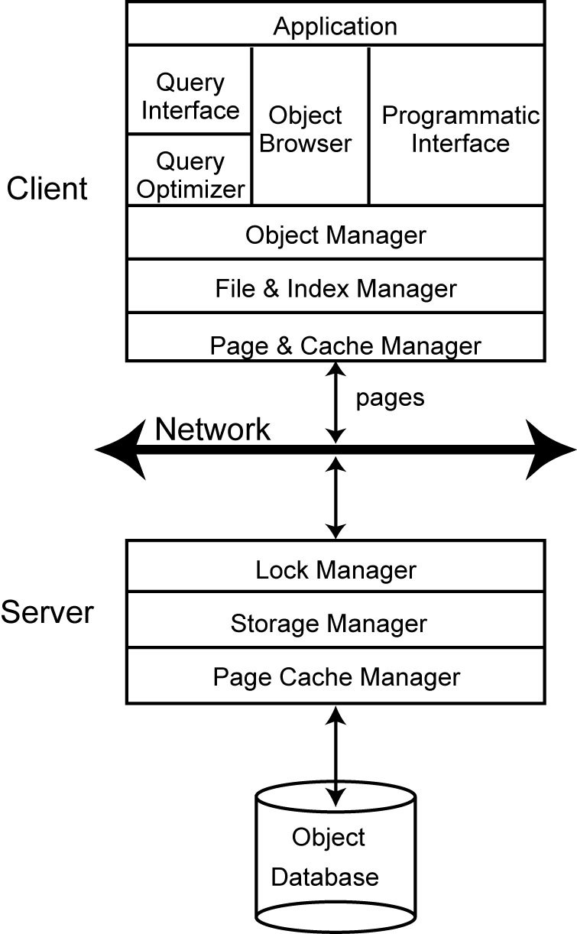
Page Server Architecture
Unit of transfer between clients and server is a physical unit of data
E.g., page or segment
DBMS services split between the client and the server
Servers typically do not have the notion of “object”
Clients have to do the conversion from an “object” to a physical unit and vice versa

Slide 13
Cache Consistency
Avoidance-based
Prevents access to stale cache data by ensuring that clients cannot update an object if it is being read by other clients
Object in cache is stale if it has already been updated and committed to the database by a different client
Stale data cannot exist in the cache
Detection-based
Detect stale object access at a validation step at commit time
Stale data is allowed to exist in the cache
Each can further classified based on when the client informs the server about writes
Synchronous
Asynchronous
Deferred

Slide 14
Alternative Cache Consistency Algorithms
Avoidance-based synchronous
Avoidance-based asynchronous
Avoidance-based deferred
Detection-based synchronous
Detection-based asynchronous
Detection-based deferred

Slide 15
Object Identifier Management
Physical object identifier (POID)
OID is equated with the physical address of the corresponding object
Address can be disk page address and an offset from the base address
Object can be obtained directly from the OID
Parent object and all indexes need to be updated when object moves
Logical identifier (LOID)
System-wide unique
A mapping has to occur to map it to the physical address
Object can be easily moved
Indirection overhead

Slide 16
Object Migration
Unit of migration
Object state but not methods
Requires invocation of remote procedures
Individual objects
Types may be accessed remotely or duplicated
Tracking objects
Surrogates or proxy objects
Placeholders: accesses to proxy objects are directed transparently by the system to the objects themselves at the new sites

Slide 17
Distributed Object Storage
Object clustering
Decomposition storage model
Partition eachobject class into binary relations (OID, attribute)
Relies on LOID
Normalized storage model
Stores each class as a separate relation
Can use LOID or POID
Direct storage model
Multi-class clustering og objects based on the composition relationship
Distributed garbage collection
Reference counting
Tracing-based
Mark and sweep
Copy-based

Slide 18
Object Query Processing
Similar approach to relational can be followed.
Additional difficulties
Complexity of the type system
Encapsulation makes knowledge of physical organization and access methods difficult
Object structures are complex requiring path expressions for access

Slide 19
Transaction Management
Difficulties resulting from the following requiremens
Operations are not simple Read and Write
Objects are not “flat” but complex and composite
Access patterns are not simple
Long running activities need to be supported
Active object capabilities are sometimes required

Slide 20
Correctness Criteria
Commutativity
Invalidation
Recoverability

